Slide 1
NINTH NATIONAL CONFERENCE ON COMPUTATIONAL INTELLIGENCE, SECURITY, AND SYSTEMS
NAC-CISS'23
Sathiyabhama Balasubramani Professor and Head,
Computer Science and Engineering, Sona College of Technology, Salem, India
sathiyabhama@sonatech.ac.in
Vidhushavarshini Sureshkumar
Assistant Professor,
Computer Science and Engineering, Sona College of Technology,
Salem, India vidhushavarshini.s@sonatech.ac.in
Dhayanithi J
Assistant Professor, Computer Science and Engineering, Sona College of Technology, Salem, India
dhaya.j@sonatech.ac.in
Rohinth S
Final year UG Student,
Computer Science and Engineering, Sona College of Technology, Salem, India
rohinth.19@sonatech.ac.in
Pooja S
Final year UG Student,
Computer Science and Engineering, Sona College of Technology, Salem, India
pooja.19@sonatech.ac.in
Rithika R
Final year UG Student,
Computer Science and Engineering, Sona College of Technology, Salem, India
rithika.19cse@sonatech.ac.in

Slide 2
TEXTURE ANALYSIS AND DISEASE PREDICTION IN NAILS USING MACHINE LEARNING

Slide 3
Abstract
In an early stage of diagnosis, this experiment suggests utilizing nail color to forecast disorders. Our project's primary goal is to study the illness without endangering people
In the older, more conventional method of disease detection, doctors would look at the patients' nails and make a diagnosis. Patients' nails can be examined to help diagnose a variety of illnesses
Our suggested solution is entirely computer-based, it can be quite helpful in resolving this problem. The suggested system's input is a picture of a nail
The technology will analyze the image of the nail and extract its attributes to determine the disease. Our suggested technique leverages variations in nail color to identify sickness

Slide 4
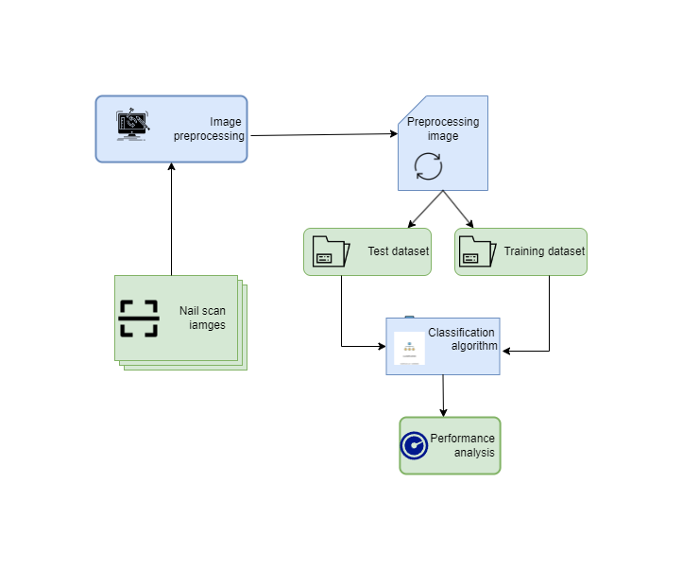
Block Diagram

Slide 5
Preprocessing
Preprocessing the data is an essential step in data analysis and machine learning
It involves cleaning and transforming the raw data into a format that can be easily analyzed by algorithms
The aim of pre-processing is an improvement of the image data that suppresses unwanted distortions or enhances some image features important for further processing
Image Pre-Processing is a common name for operation with images at the lowest level of abstraction. Its input and output are intense images

Slide 6
Noise Removal
Noise removal refers to the process of removing unwanted or extraneous information from a signal or data set, with the goal of improving the accuracy or quality of the remaining information
In the context of digital signal processing or image processing, noise refers to any random or unwanted information that is added to a signal or image during acquisition, transmission, or processing
Examples of noise include electrical interference, background noise in audio recordings, and artifacts or distortion in digital images

Slide 7
NOISE REMOVAL METHODS
Rayleigh Noise
Gaussian Noise
Salt And Pepper Noise
Shape Noise
Erlan (GAMMA) Noise
Exponential Noise

Slide 8
Accuracy of our proposed technique in noise reduction compared with conventional techniques.
Rayleigh Noise | 10% | 15%
Gaussian Noise | 0.5560 | 0.5694
Salt And Pepper Noise | 0.4960 | 0.4992
Shape Noise | 0.3524 | 0.3714
Erlan (GAMMA) NOISE | 0.1724 | 0.1624
Exponential Noise | 0.1245 | 0.1256

Slide 9
Data Set(Training and Testing)
Before classification, the resulting dataset must be divided into training and test sets. Building accurate predictive models on decomposed training datasets and evaluating model accuracy on new data are the main goals of machine learning algorithms. The model test data set provides data to confirm the correctness of the model. Using random percentages (such as 80% for training and 20% for testing) is the easiest way to divide your training and testing data sets. When determining the training and test data for a model, there will be an error in dividing the data into percentages, depending on the distribution of the data. The cross-validation technique is used to divide all data into training and test datasets to avoid this situation. The data was first divided into 4 independent groups, one of which was used for testing, and the other nine were used for training. This process is carried out 4 times. The final success rate was then determined by averaging the classification successes for each procedure.
NO | Dataset | No.of Image data
1 | NSD | 204
2 | TBND | 306
3 | NDDI | 300
4 | NFD | 1200

Slide 10
Classification Algorithms and its Accuracy
NO | Classification Method | Accuracy | F1 | Recall | Precision
1 | Convolutional Neural Network | 0.8737 | 0.8734 | 0.8735 | 0.8754
2 | Random Forest Classifier | 0.8676 | 0.8679 | 0.8669 | 0.8682
3 | K-Nearest Neighbors | 0.8661 | 0.8650 | 0.8650 | 0.8667
4 | Decision Tree Classifier | 0.8663 | 0.8654 | 0.8646 | 0.8693
5 | Naive Bayes classifier | 0.8645 | 0.8636 | 0.8635 | 0.8684
6 | Support Vector Machine | 0.8634 | 0.8627 | 0.8623 | 0.8639

Slide 11
Classification using CNN Algorithm
The CNN (Convolutional Neural Network) classification algorithm is a type of deep learning algorithm used for image classification tasks.
In machine learning, the algorithm is trained on a dataset of labeled images, where each image is associated with a class label.
The following is a high-level overview of the CNN classification algorithm in machine learning
Overall, CNNs have been shown to be highly effective for image classification tasks and have been used in a wide range of applications for medical image analysis.

Slide 12
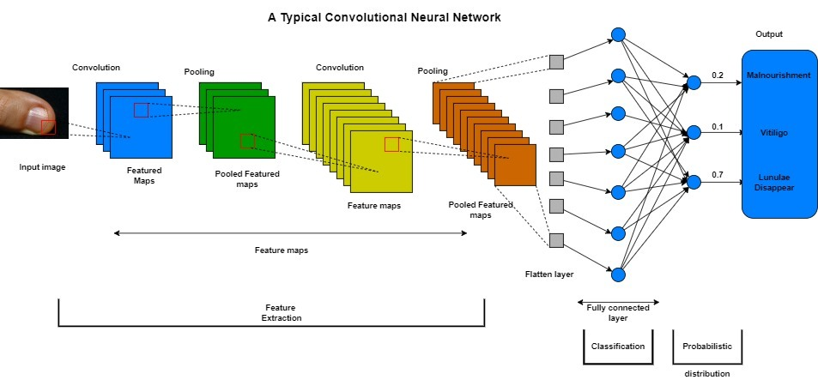
Classification using CNN Algorithm

Slide 13
CONCLUSION
Texture analysis and disease prediction in nails using machine learning is a promising approach for the early diagnosis and treatment of nail diseases. In this technique, texture features are extracted from images of nails, which are then used to train machine-learning models for nail disease prediction. Using machine learning algorithms, this approach can accurately detect nail diseases and distinguish them from healthy nails. This can lead to earlier detection and treatment of nail diseases, which can improve patients' overall health and quality of life. analyzing all papers, we take the number of datasets of four. We have given an algorithm with 87% accuracy. In our upcoming effort, we intend to investigate additional classification enhancement.

Slide 14
References
[1] Indi Trupti, Yogesh A. Gunge, “Early Stage Disease Diagnosis System Using Human Nail Image Processing”, I.J. Information Technology And Computer Science, Vol. 7, Pp.30-35 , 05-07-2016
[2] Hardik Pandit , Dr. D M Shah, ”A System For Nail Color Analysis In Healthcare”, International Conference On Intelligent Systems And Signal Processing, Pp. 221-223, 2013.
[3] Indrakumar S S, Dr. M S Shashidhara, ”Study On Eye Troubles Using Palm Print And Image Processing Technique”, International Journal Of Recent Trends In Engineering & Research (Ijrter),Volume 02, Issue 05, Pp. 198-201, May – 2016.
[4] A. J. Humaidi and M. A. Fadhel, Performance comparison for lane detection and tracking with two different techniques, 2016 Al-Sadeq International Conference on Multidisciplinary in IT and Communication Science and Applications (AIC-MITCSA), pp.1-6, DOI: 10.1109/AIC-MITCSA. 2016.7759943, 2016.
[5] V.Saranya, Dr.A.Ranichitra,” Image Segmentation Techniques To Detect Nail Abnormalities”, International Journal Of Computer Technology & Applications, Vol.-8, Issue- 4, Pp.522-527, 2017.
[6] Sneha Gandhat, A. D. Thakare, Swati Avhad, Nityash Bajpai, Rohit Alawadhi, “ Study And Analysis Of Nail Images Of Patients”, International Journal Of Computer Applications, Volume 143 – No.13, June 2016

Slide 15
[7] M. A. Fadhel, A. J. Hamidi and S. R. Oleiwi, Image processing-based diagnosis of sickle cell anemia in erythrocytes, Annual Conference on New Trends in Information & Communications Technology Applications (NTICT), 2017.
[8] L. Alzubaidi, M. Al-Amidie, A. Al-Asadi, A. J. Humaidi, O. Al-Shamma, M. A. Fadhel, J. Zhang, J. Santamar´ıa and Y. Duan, Novel transfer learning approach for medical imaging with limited labeled data, Cancers (Basel), vol.13, no.7, DOI: 10.3390/cancers13071590, 2021.
[9] R. Nijhawan, R. Verma, Ayushi, S. Bhushan, R. Dua and A. Mittal, An integrated deep learning framework approach for nail disease identification, Proc. of the 13th Int. Conf. Signal-Image Technol. Internet-Based Syst. (SITIS2017), pp.197-202, DOI: 10.1109/SITIS.2017.42, 2018.
[10] V. Maeda-Guti´errez et al., Comparison of convolutional neural network architectures for classification of tomato plant diseases, Appl. Sci., vol.10, no.4, DOI: 10.3390/app10041245, 2020.
[11] L. Alzubaidi, J. Zhang, A. J. Humaidi et al., Review of deep learning: Concepts, CNN architectures, challenges, applications, future directions, Journal of Big Data, vol.8, DOI: 10.1186/s40537-021- 00444-8, 2021.
[12] M. Yani, B. Irawan and C. Setiningsih, Application of transfer learning using convolutional neural network method for early detection of Terry’s nail, J. Phys. Conf. Ser., DOI: 10.1088/1742- 6596/1201/1/012052, 2019.
[13] J. Jefferson and P. Rich, Melanonychia, Dermatol. Res. Pract., DOI: 10.1155/2012/952186, 2012.

Slide 16
[14] K. E. Spicknall, M. J. Zirwas and J. C. English, Clubbing: An update on diagnosis, differential diagnosis, pathophysiology, and clinical relevance, J. Am. Acad. Dermatol., vol.52, no.6, pp.1020- 1028, DOI: 10.1016/j.jaad.2005.01.006, 2005.
[15] B. M. Piraccini and A. Alessandrini, Onychomycosis: A review, J. Fungi, vol.1, no.1, pp.30-43, DOI: 10.3390/jof1010030, 2015. 1282 J. ABDULHADI, A. AL-DUJAILI, A. J. HUMAIDI AND M. A.-R. FADHEL
[16] V. Sharma and M. Ramaiya, Nail color and texture analysis for disease detection, Int. J. Bio-Science Bio-Technology, vol.7, no.5, pp.351-358, DOI: 10.14257/ijbsbt.2015.7.5.34, 2015.
[17] M. Al-Amidie, A. Al-Asadi, A. J. Humaidi, A. Al-Dujaili, L. Alzubaidi, L. Farhan, M. A. Fadhel, R. G. McGarvey and N. E. Islam, Robust spectrum sensing detector based on mimo cognitive radios with non-perfect channel gain, Electronics, vol.10, no.5, DOI: 10.3390/electronics10050529, 2021.
[18] Sureshkumar, V., Balasubramaniam, S., Ravi, V. and Arunachalam, A., 2022. A hybrid optimization algorithm‐based feature selection for thyroid disease classifier with rough type‐2 fuzzy support vector machine. Expert Systems, 39(1), p.e12811.
[19] Vidhushavarshini, S. and Sathiyabhama, B., 2017, November. A Comparison of Classification Techniques on Thyroid Detection Using J48 and Naive Bayes Classification Techniques. In Proceedings of the International Conference on Intelligent Computing Systems (ICICS 2017–Dec 15th-16th 2017) organized by Sona College of Technology, Salem, Tamilnadu, India.

Slide 17
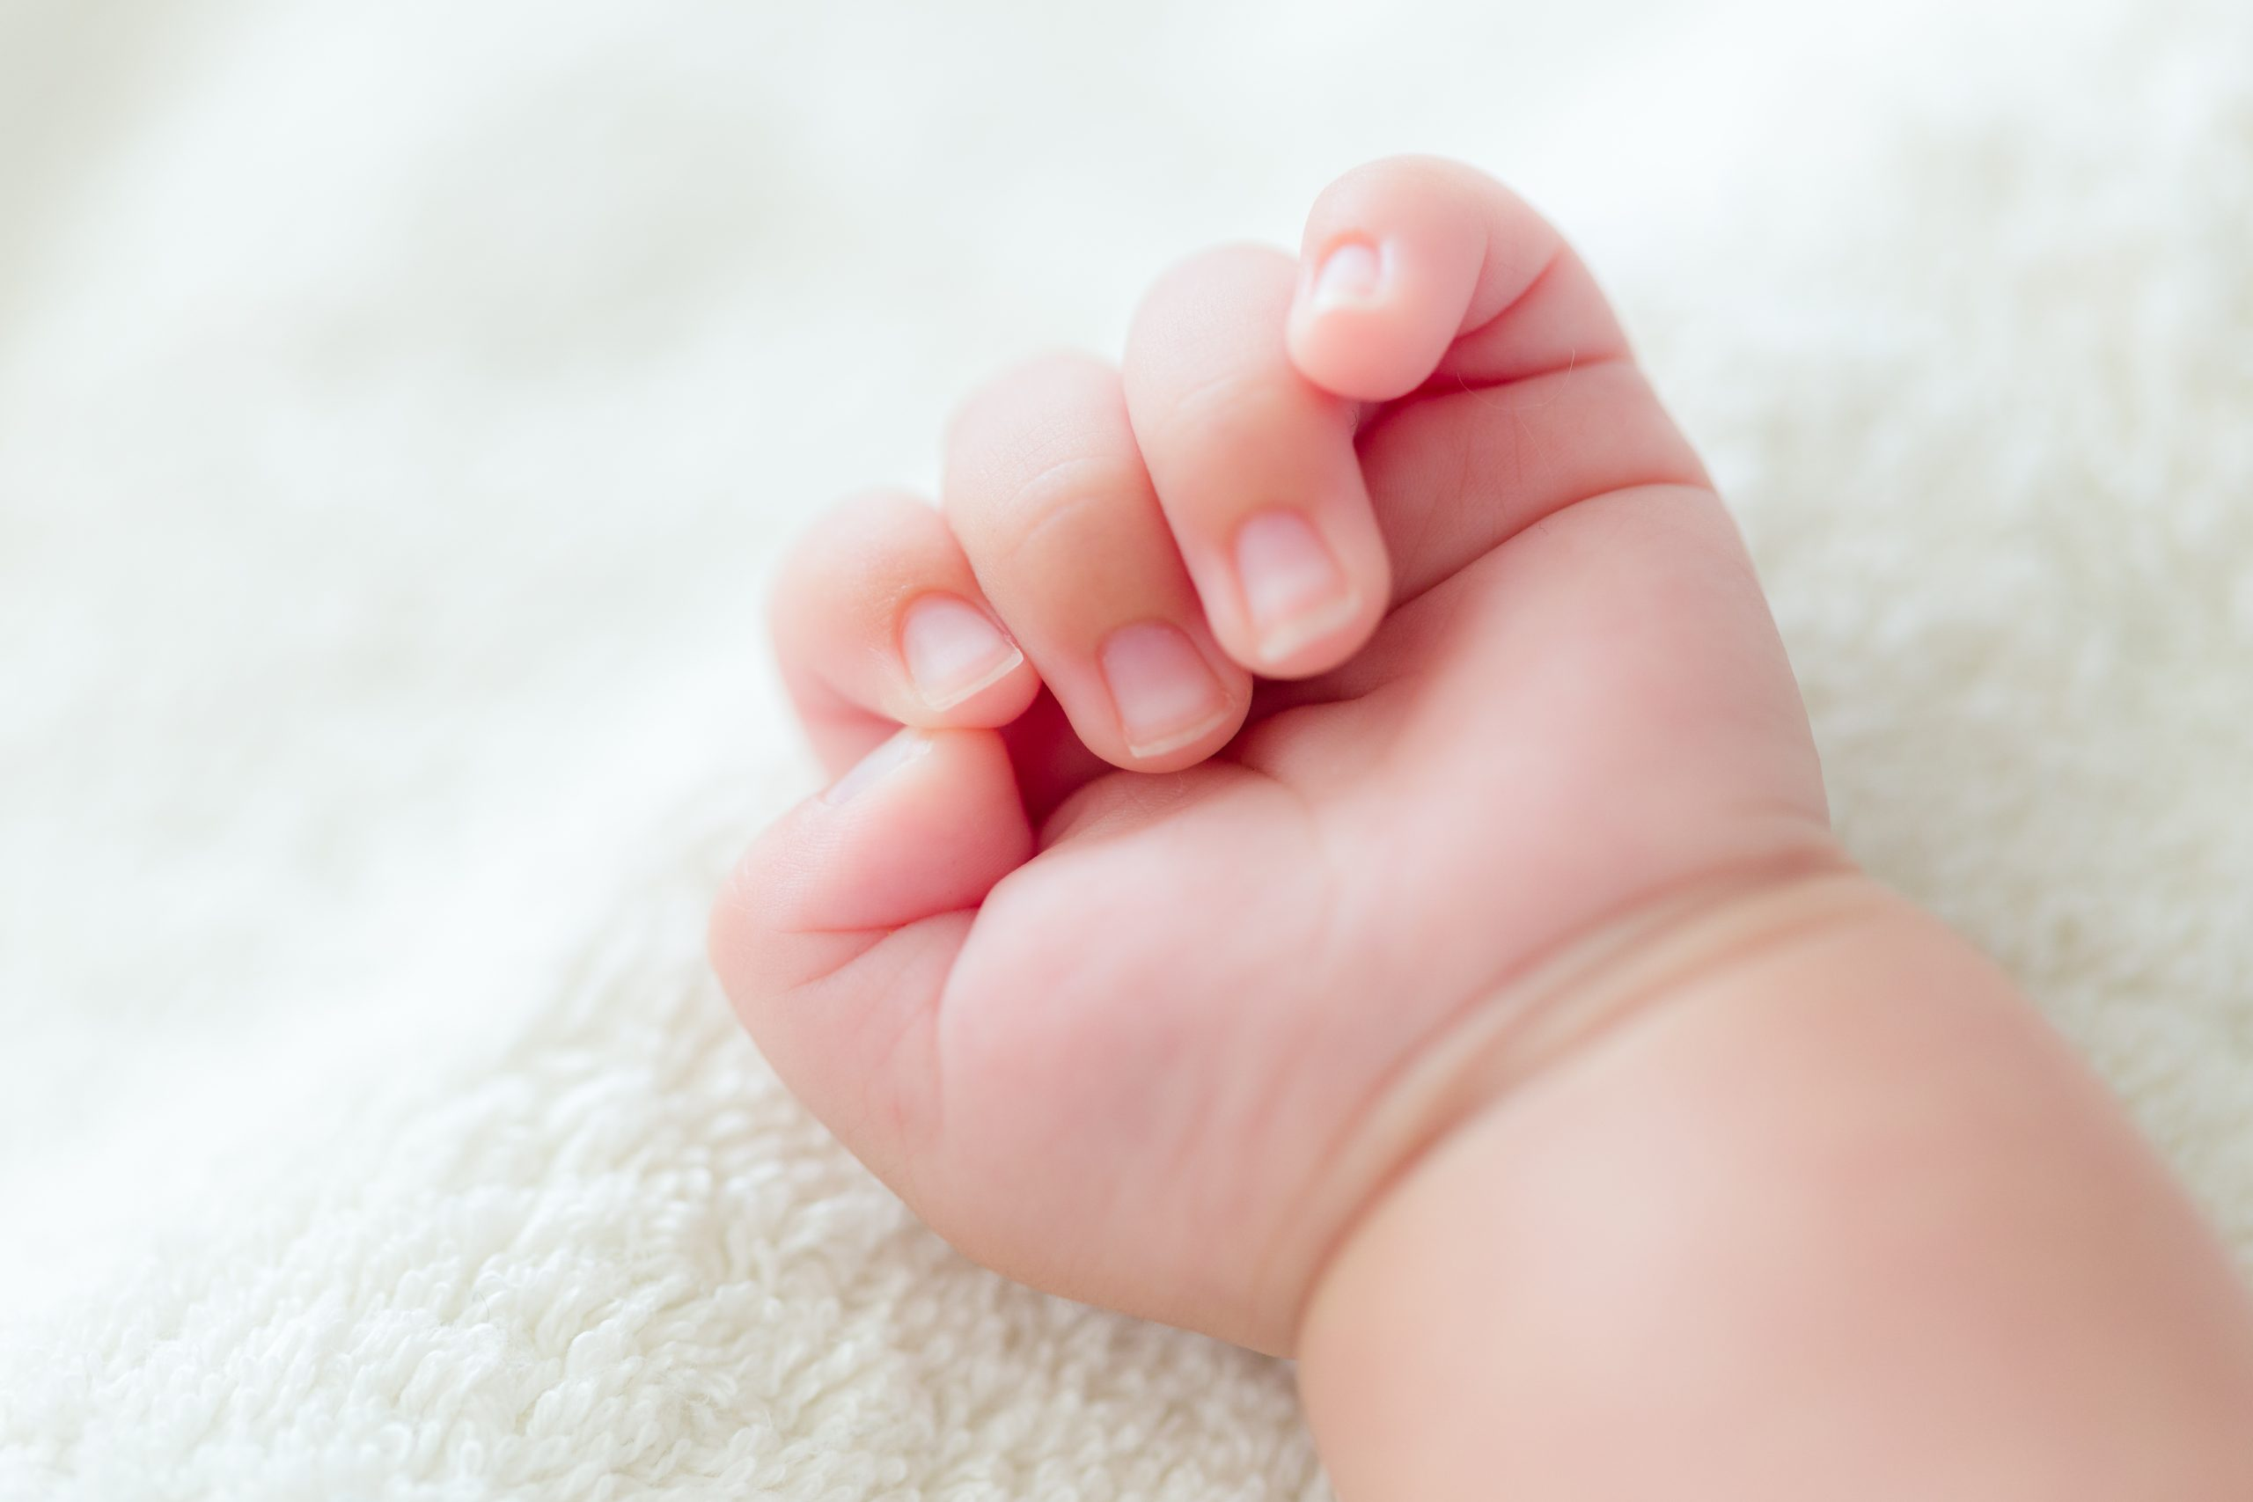
Thank You
THANK YOU

